Slide 1







Slide 2












A Presentation by Rahel A., Rahel H., Janina and Anina

Slide 3



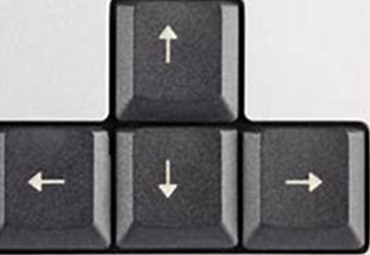










Why Tetris?
Blocks fall continuously
The arrow keys (left, right, down)
The space key (rotating)
The goal of the game
More options and ideas
Tetris!
The occurring problems

Slide 4



Why Tetris?
Blocks fall continuously
The arrow keys (left, right, down)
The space key (rotating)
The goal of the game

Slide 5
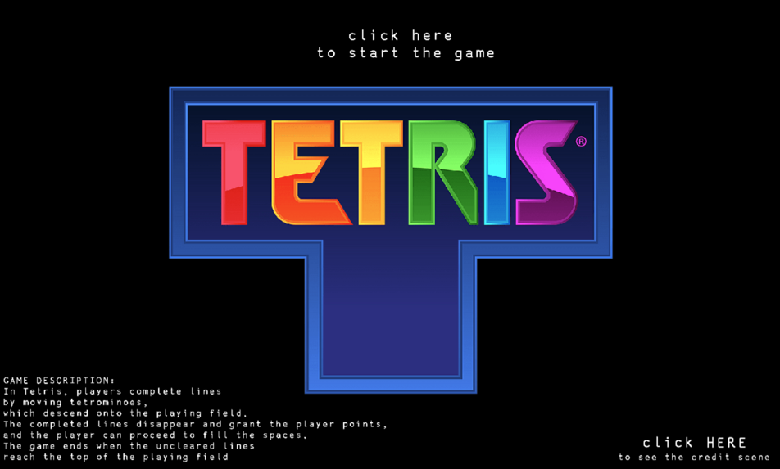
Demonstration of the game

Slide 6



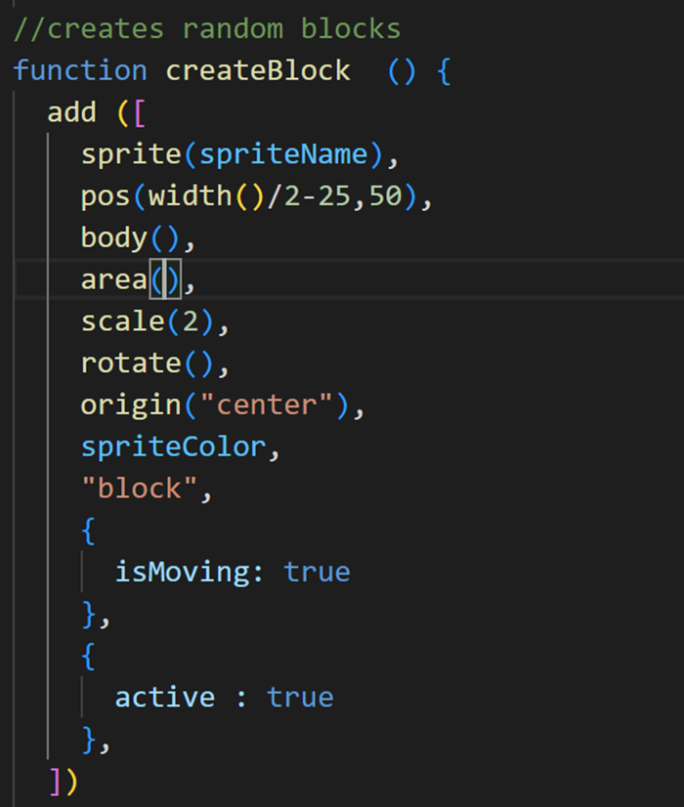
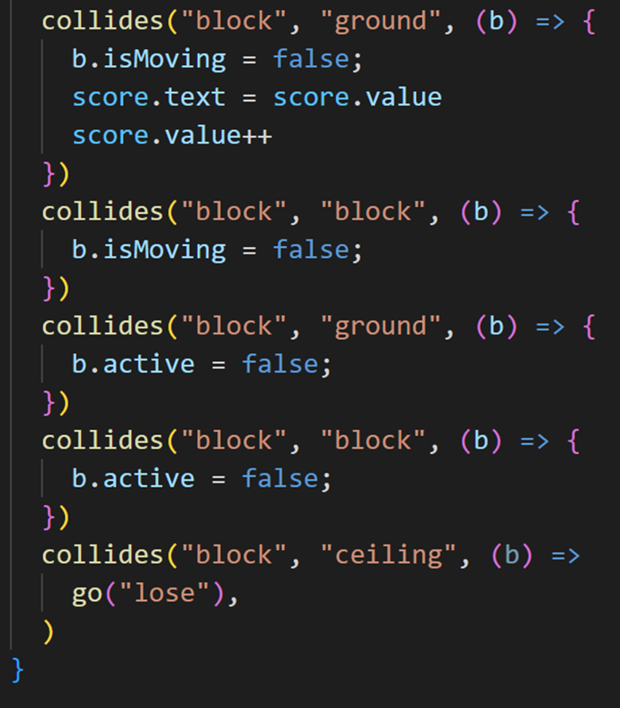
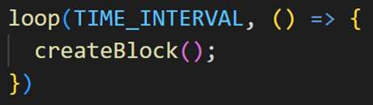
Explanation of the code
- Coding of the blocks
The starting scene:

Slide 7



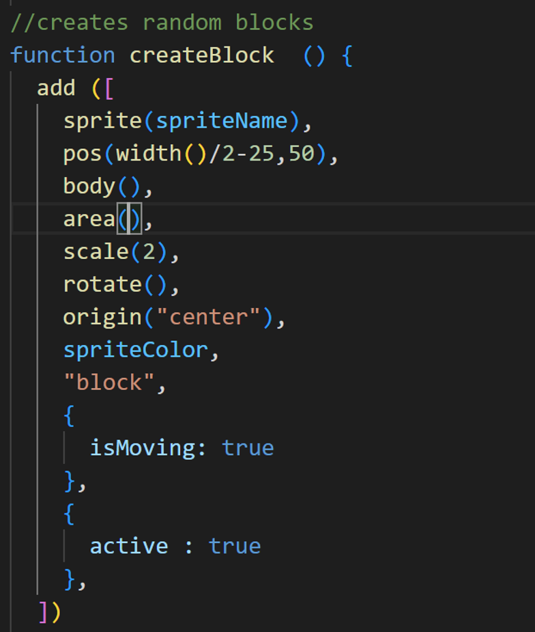

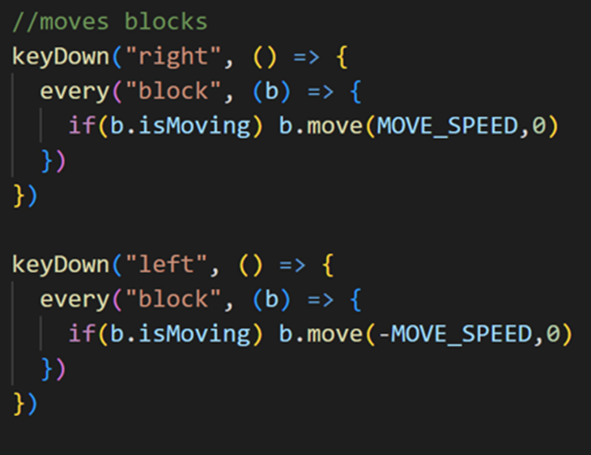
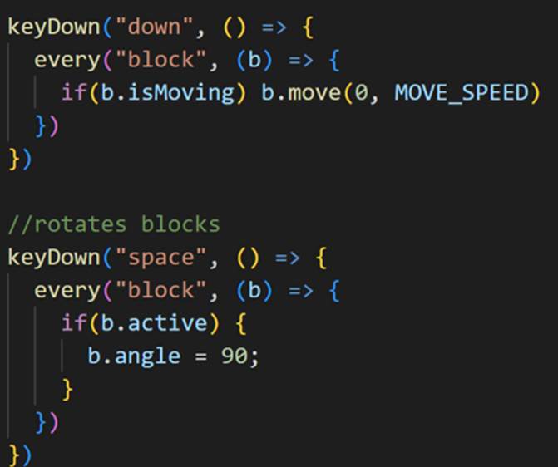

- Coding of the blocks

Slide 8



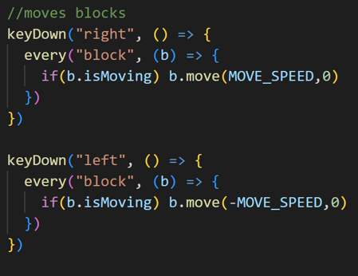


Slide 9

Hard start
Coordination of work
First file
Second file
Third file
Struggles

Slide 10




